Slide 2
2026/07/30 00:52 A.M.
UNIX TIMESTAMP: 1785343973
2026/07/30 00:52 A.M.
UNIX TIMESTAMP: 1785343972
2026/07/30 00:52 A.M.
UNIX TIMESTAMP: 1785343971
2026/07/30 00:52 A.M.
UNIX TIMESTAMP: 1785343970
Notes:
用動畫做時間流動的效果

Slide 3
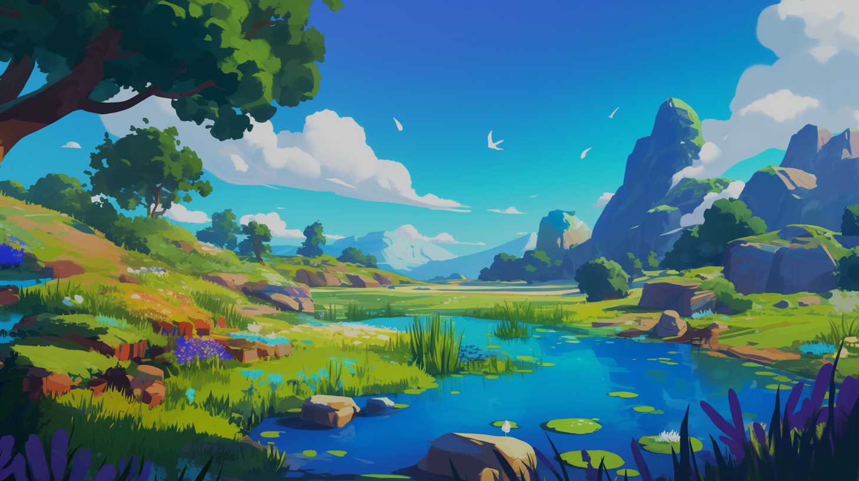


Slide 4
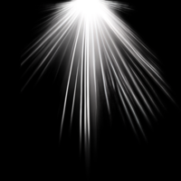
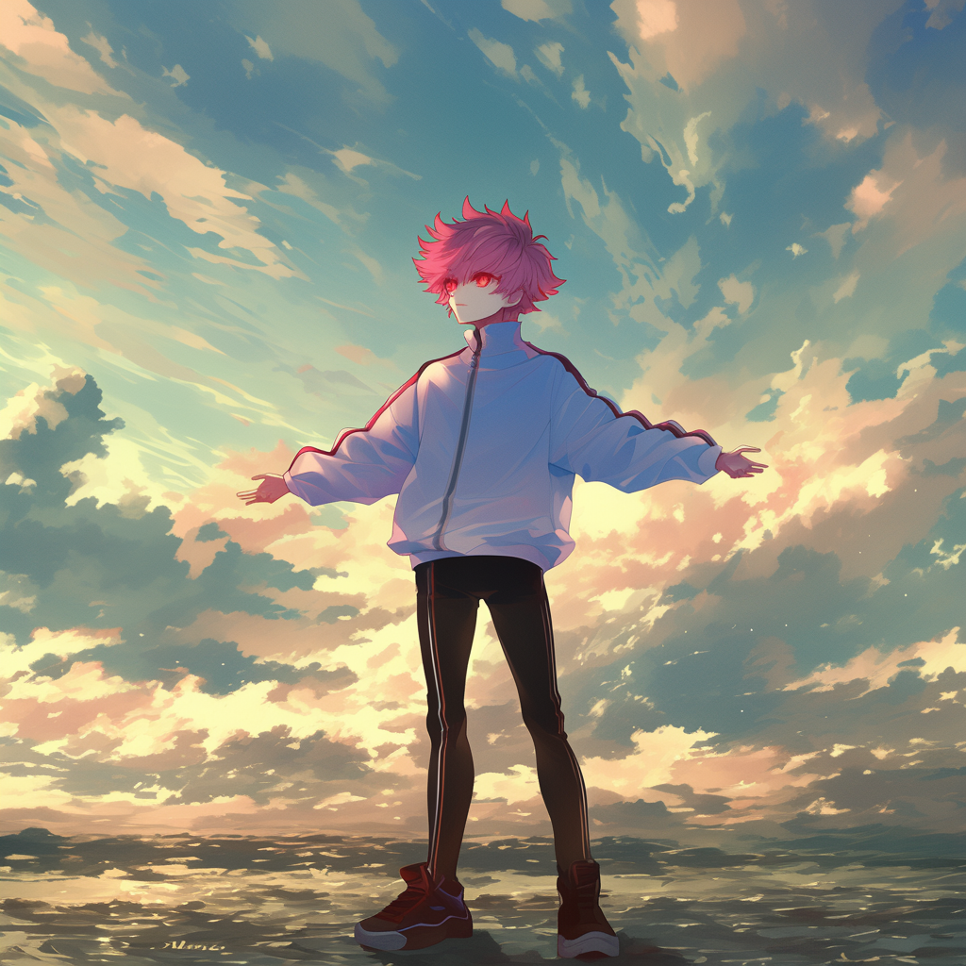
1. 目標
Notes:
同Clip03
使用Midjourney的niji6模型
有將自己的人設圖片餵給AI參考
Prompt:
A person standing in a serene landscape, arms outstretched, gazing towards the sky with a feeling of acceptance and serenity, embracing the vastness of the sky and receiving its blessings, under a dramatic cloudy or sunny sky with soft lighting and a gentle breeze, clean background --cref <圖片網址> --ar 1:1 --niji 6
並且後製素材

Slide 5
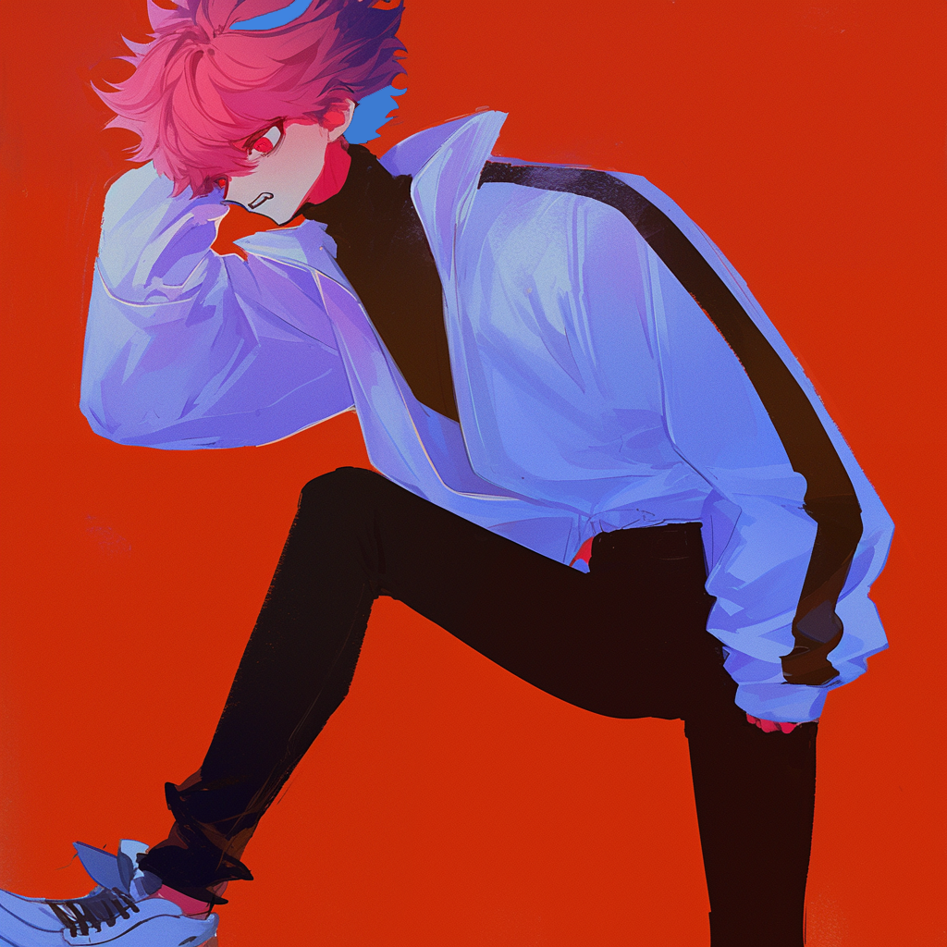
2. 阻礙
Notes:
同Clip03
使用Midjourney的niji6模型
有將自己的人設圖片餵給AI參考
Prompt:
A character clutching their head in distress, showcasing panic and anxiety, dramatic expression with a focus on emotional tension, soft lighting emphasizing facial features, surrounded by a minimalistic background to isolate the emotion. --cref <圖片網址> --niji 6 --ar 1:1
並稍微小修一下

Slide 6
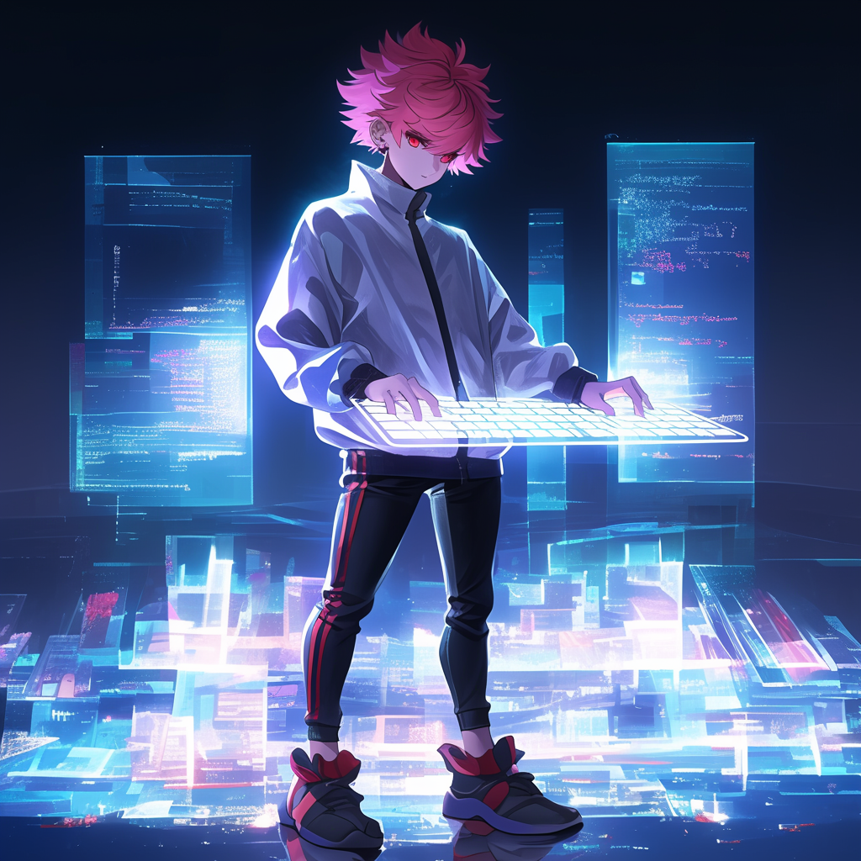
3. 努力
Notes:
使用Midjourney的niji6模型
有將自己的人設圖片餵給AI參考
Prompt:
A character in a futuristic setting, standing in front of a transparent, glowing virtual keyboard. The character is pressing keys in the air, with their fingers hovering above the invisible keys. The background is a high-tech environment, with sleek holographic interfaces and digital data flowing around. The character is focused and appears engaged in an intense moment of virtual interaction, with soft lighting illuminating their face and hands. --cref https://s.mj.run/oP4BV2XKGOU --niji 6 --ar 1:1

Slide 7
A Few Moments Later

Slide 8
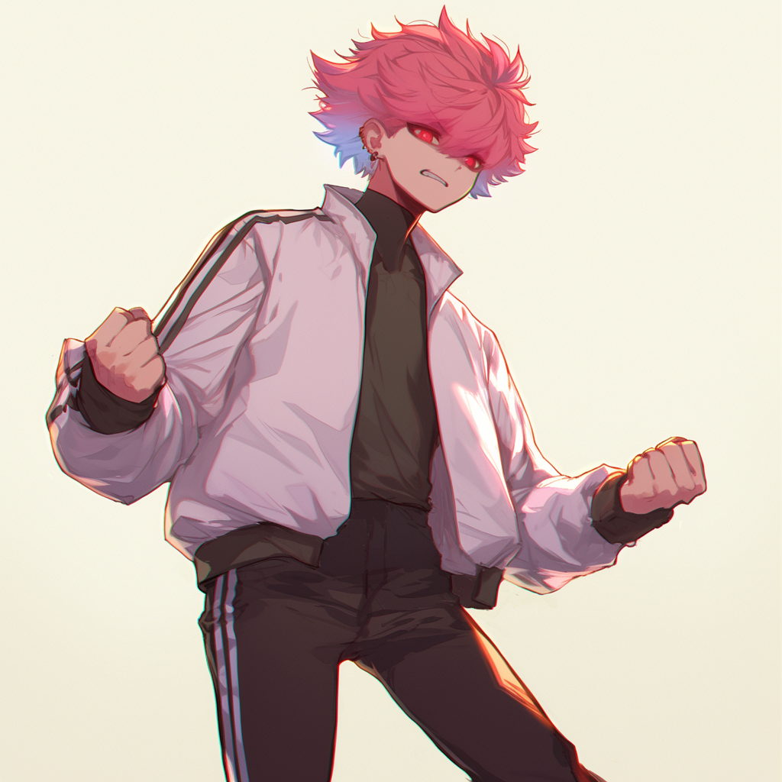
4. 結果
Notes:
使用Midjourney的niji6模型
有將自己的人設圖片餵給AI參考
Prompt:
A character with a frustrated and unwilling expression, clenching their fists tightly. The character‘s face shows a mixture of determination and anger, their eyes narrowed in defiance. The atmosphere feels tense and emotional, emphasizing their inner turmoil. The character is standing in a slightly dynamic pose, ready for action, with a strong, intense aura surrounding them. The background is neutral to keep the focus on the character’s emotions. --cref <圖片網址> --niji 6 --ar 1:1

Slide 9
5. 意外

Slide 10
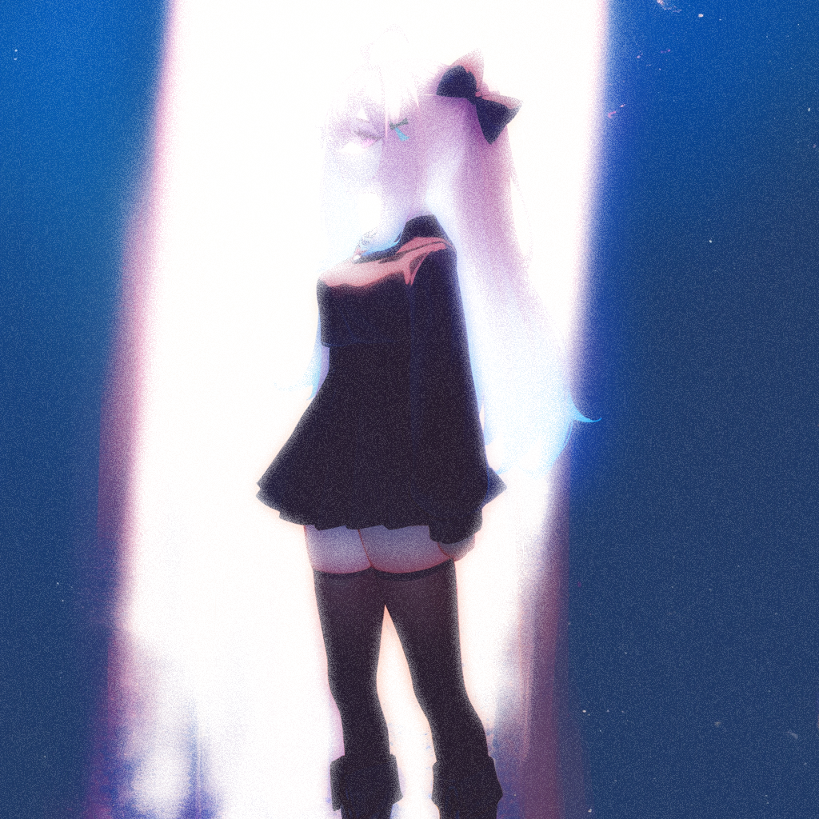
問
問：
問：你
問：你是
問：你是我
問：你是我的
問：你是我的主
問：你是我的主人
問：你是我的主人嗎
問：你是我的主人嗎？
5. 意外
Notes:
使用Midjourney的niji6模型
先前已先詠唱人設三視圖：https://drive.google.com/file/d/12-fQc4Op9qgL6vCgg8uxsQPjL6lC7-CO/view?usp=drive_link
人設三視圖是慢慢用Region Vary修的，基本Prompt:
A sixteen years old girl, height 158cm, middle hair (length is under shoulder a little), pink hair with a handful of baby blue highlight in the tail of hair::2 , deep red eyes, wearing Jirai Kei style fashion, wearing big bow hair accessories, Genshin Impact style. Displayed on a single canvas with three distinct, full-body views: 1) complete front view, 2) complete side view, and 3) complete back view. Each view should show the entire figure, full body in all views, clean white background, highly detailed, character design, 4K, UHD quality --no earrings, long hair --niji 6 --ar 65:73
此張圖Prompt:
Create an image of a girl with pink hair standing in a beam of light. Only her silhouette is visible, with no detailed features, as she is bathed in soft, glowing light, creating an aura around her. --cref https://s.mj.run/kCpNbICRCCo --niji 6 --ar 1:1
並且套用PPT的美術效果處理

Slide 11
Notes:
做出閃一下的效果

Slide 12
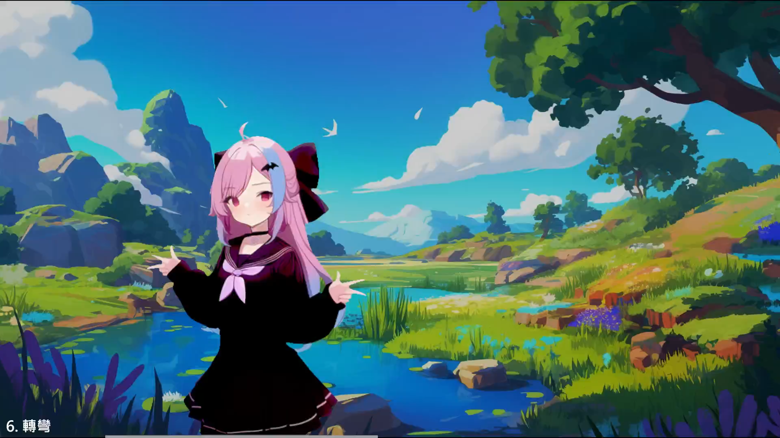
答
答：
答：已
答：已讀
答：已讀取
答：已讀取完
答：已讀取完畢
答：已讀取完畢，
答：已讀取完畢，外
答：已讀取完畢，外觀
答：已讀取完畢，外觀建
答：已讀取完畢，外觀建構
答：已讀取完畢，外觀建構完
答：已讀取完畢，外觀建構完畢
答：已讀取完畢，外觀建構完畢！
否，你該醒
否
否，
否，你
否，你該
否，你該醒了
否，你該醒了。
6. 轉彎
Notes:
這邊是預錄的影片

Slide 13
6. 轉彎
Notes:
做出閃一下的效果

Slide 14
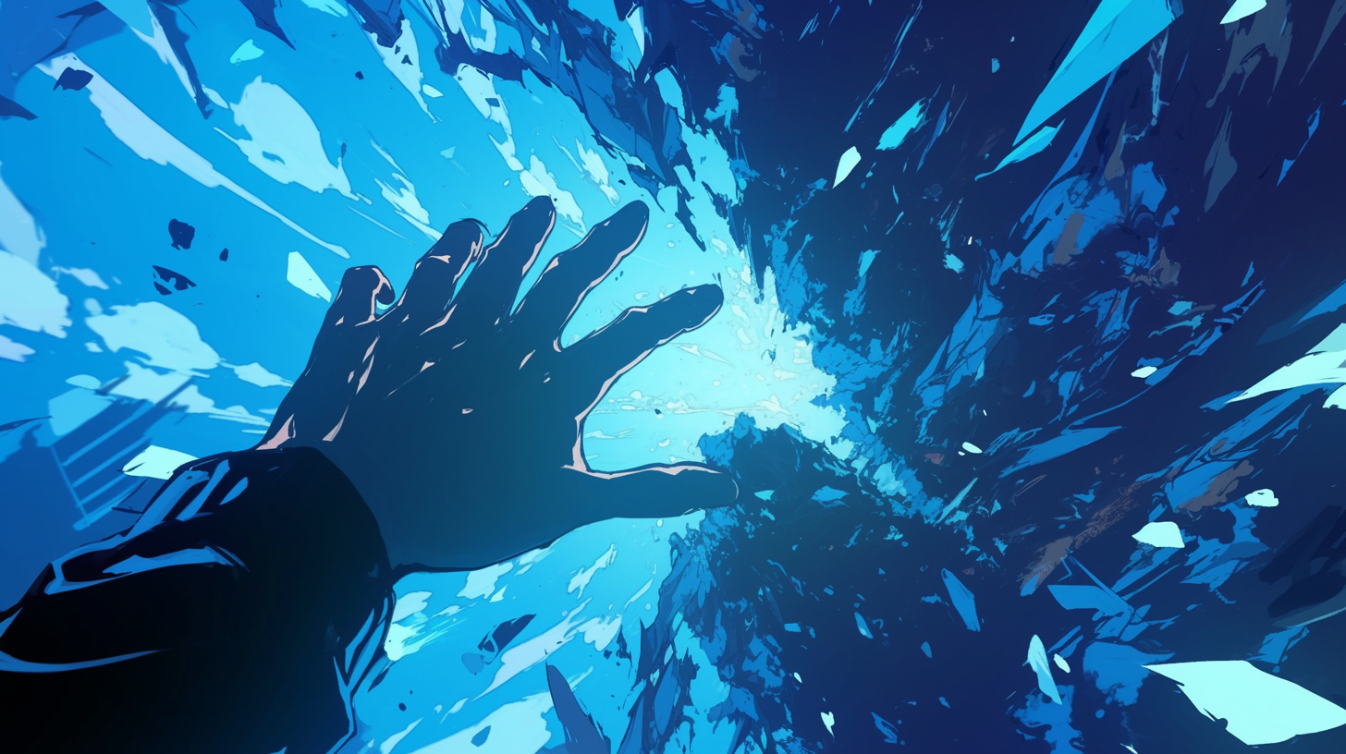
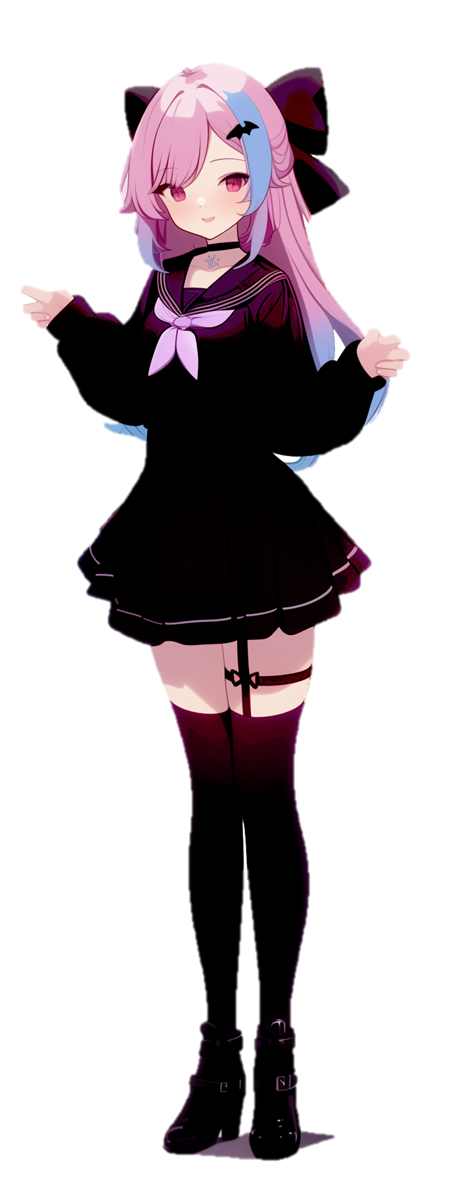
6. 轉彎
Notes:
使用Midjourney的niji6模型
有將人設圖片餵給AI參考
Prompt:
First-person perspective of falling towards a cliff, with the viewpoint looking at a character standing at the edge of the cliff. Showing his hand to do capture action. The character is silhouetted against a dramatic sky, with windswept hair and a determined stance. The landscape below is vast, with jagged rocks and a dark abyss beneath. anime style. --niji 6 --ar 16:9
並將人放進來用PPT的美術功能後製

Slide 16
2026/06/15 12:32 P.M.
UNIX TIMESTAMP: 1781497954
2026/07/30 00:54 A.M.
UNIX TIMESTAMP: 1785344099
2026/07/30 00:55 A.M.
UNIX TIMESTAMP: 1785344120
2026/07/30 00:55 A.M.
UNIX TIMESTAMP: 1785344123
2026/07/30 00:55 A.M.
UNIX TIMESTAMP: 1785344122
2026/07/30 00:55 A.M.
UNIX TIMESTAMP: 1785344121
2026/04/04 04:04 A.M.
UNIX TIMESTAMP: 1775246644
2026/07/29 04:59 P.M.
UNIX TIMESTAMP: 1785315574
Notes:
用動畫做時間倒流的效果

Slide 18
2025/01/01 00:00 A.M.
UNIX TIMESTAMP: 1735660858
2025/01/01 00:00 A.M.
UNIX TIMESTAMP: 1735660859
2025/01/01 00:01 A.M.
UNIX TIMESTAMP: 1735660860
2025/01/01 00:01 A.M.
UNIX TIMESTAMP: 1735660861
Notes:
用動畫做時間流動的效果

Slide 19
7. 結局

Slide 20
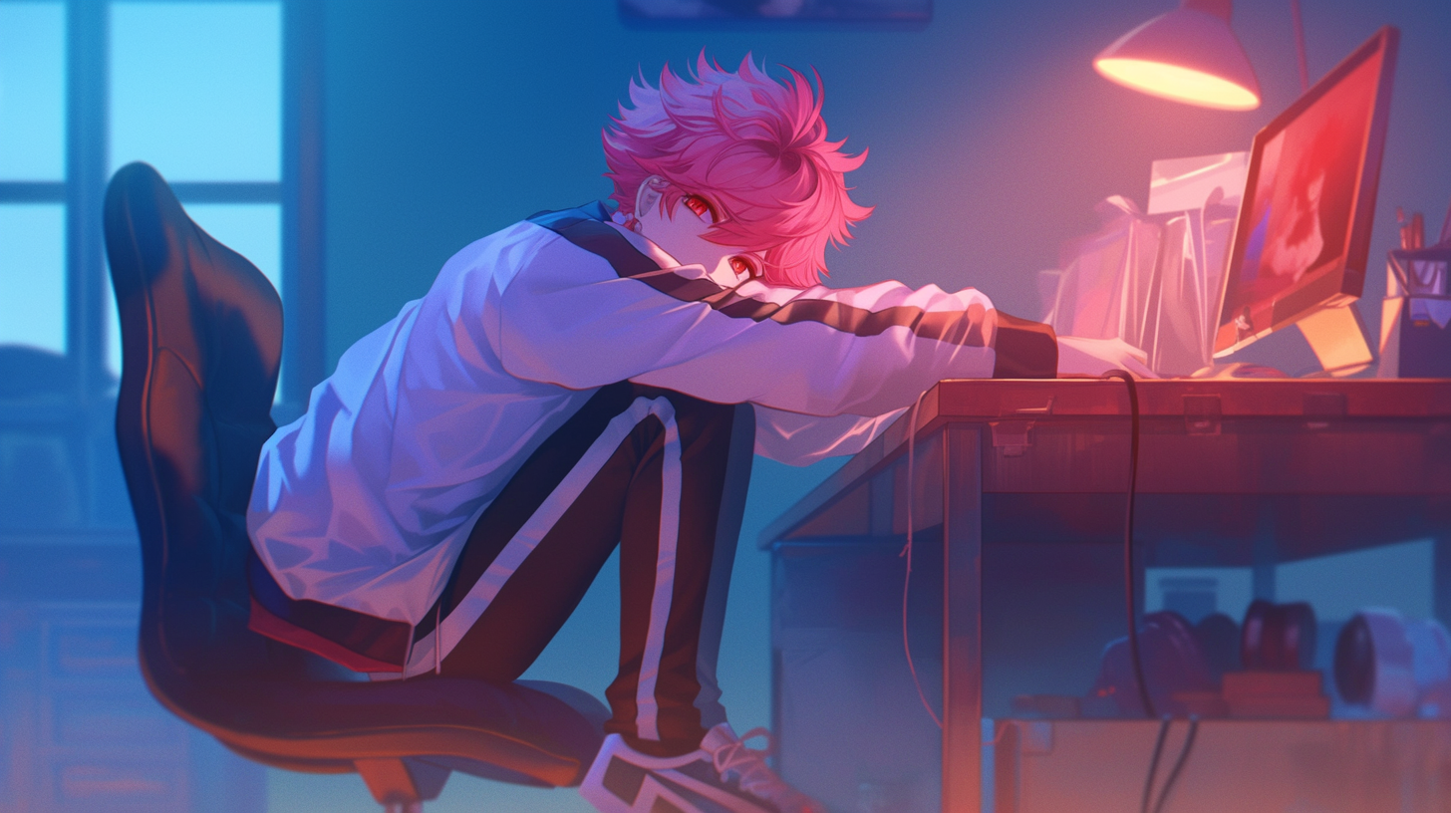
7. 結局
Notes:
同Clip01

Slide 21
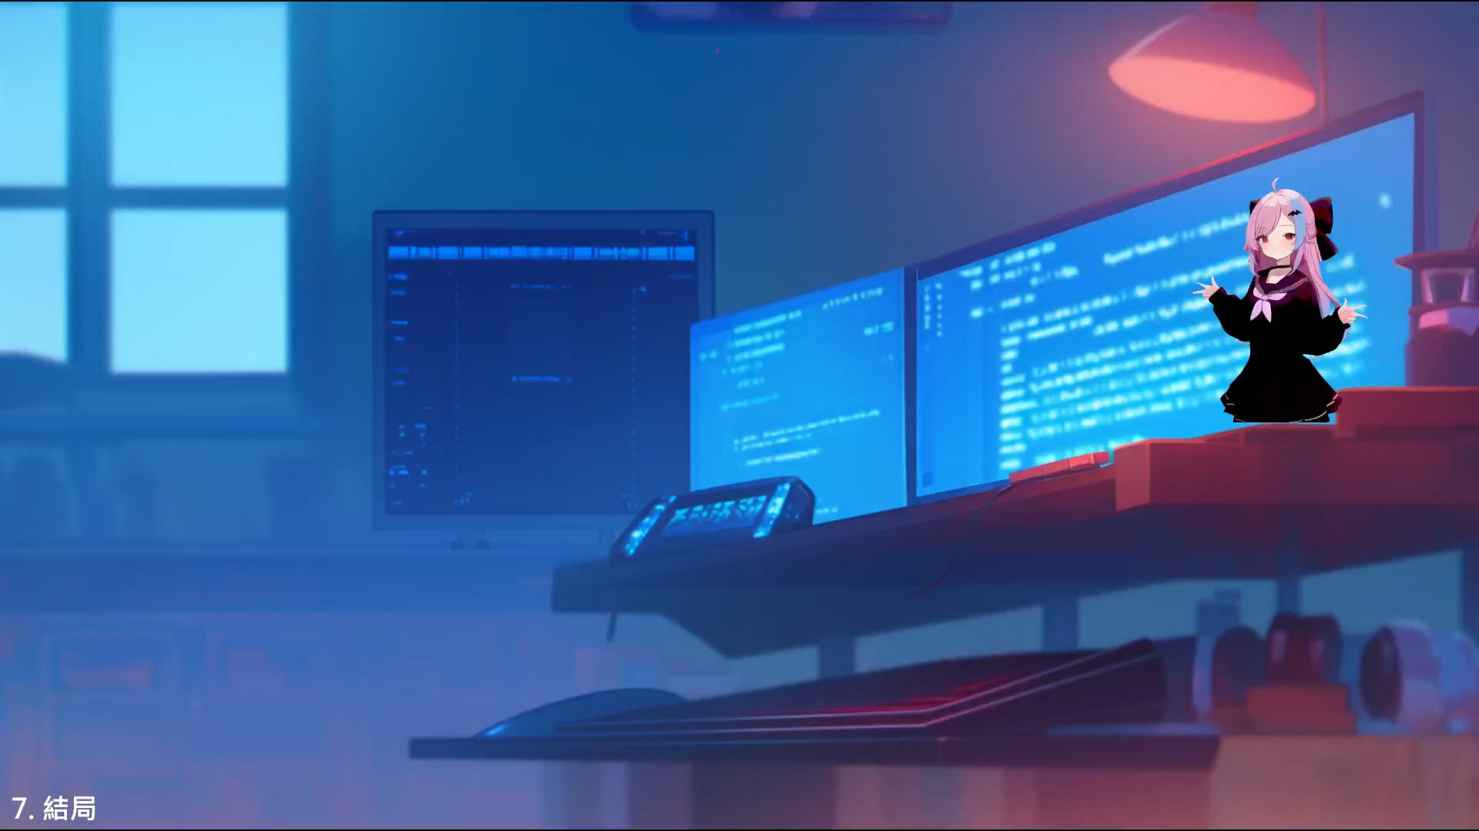

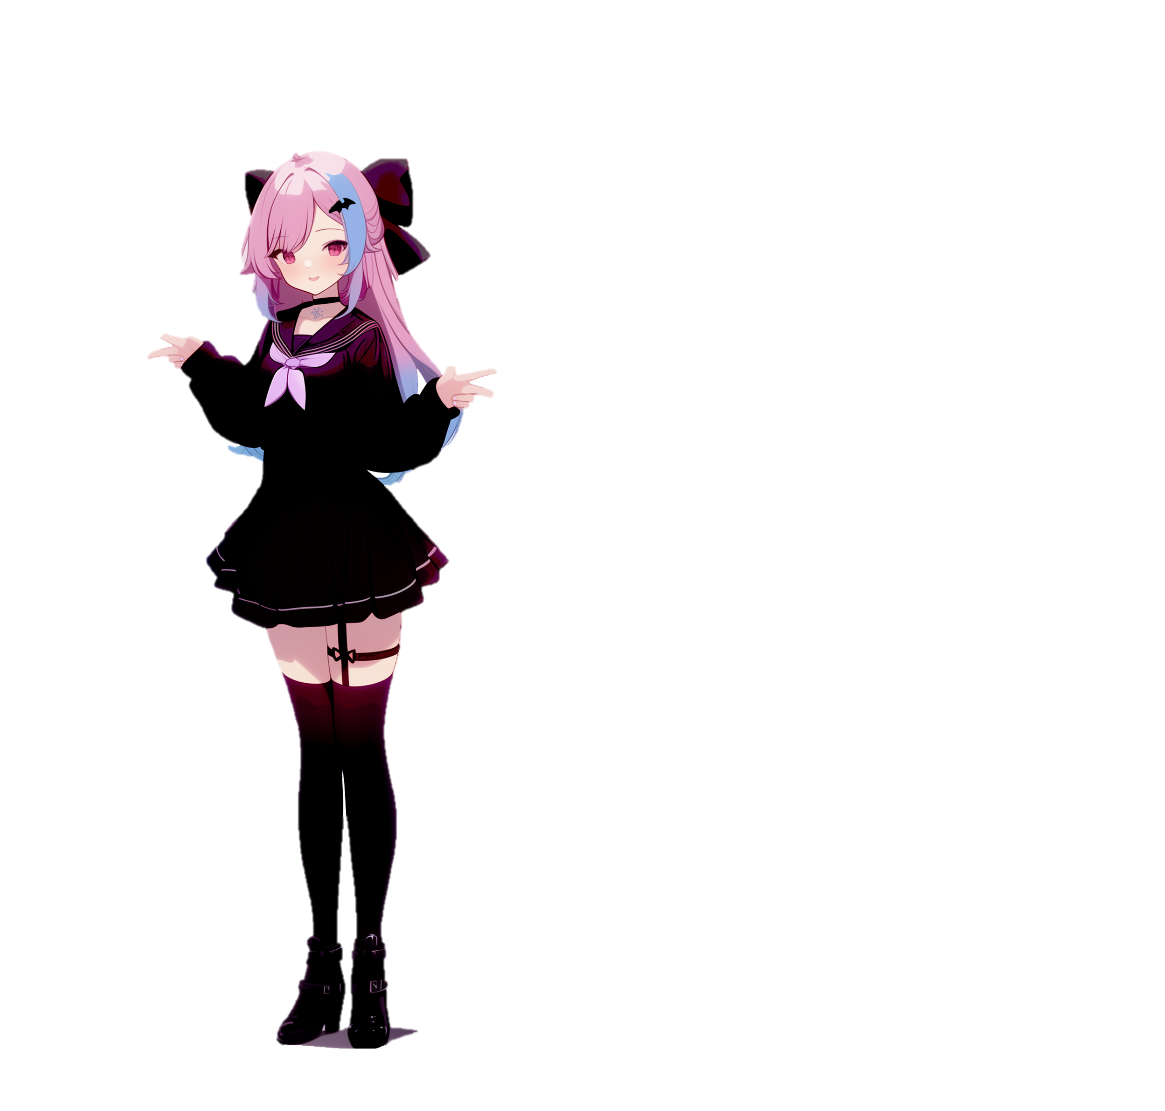
尋到有個關於聲音的開源模型叫『SOUNA』，或許可以嘗試
答：嘿嘿！我來達成主人的願望！也想捉弄一下你！
算了，順帶一提，
我都會存在於你的電腦及手機中喔
喔對了，你現在跟你所謂的觀測者應該是處在同一時空喔
答：我是你遊戲中建構的AI啊！
因為我讀取了你的性癖。
答：太中二了吧= =
答：我只是AI欸！
…
2025/01/01 00:00 A.M.
7. 結局
Notes:
同Clip01，但使用Region Vary把角色移除
然後用ppt的動畫做了一些對話

